Slide 1
Triad L Seminar
Tuesday, February 2d

Slide 2
Review quiz
Say hello and introduce yourself to your neighbors around you.
I have a mini review over some of the thing you have gone over in political science.
You can use your notes and you can use the classmates sitting next to you.
You have 10 minutes to complete this.

Slide 3
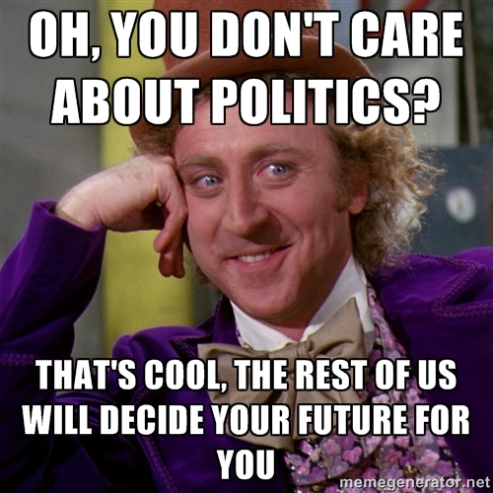
7 Deadly sins of the state
Your main research project will as you to connect an issue to:
  Politics
  An issue of Texas concern
  What organization/department is responsible?
  Connect it to a Deadly Sin

Slide 4
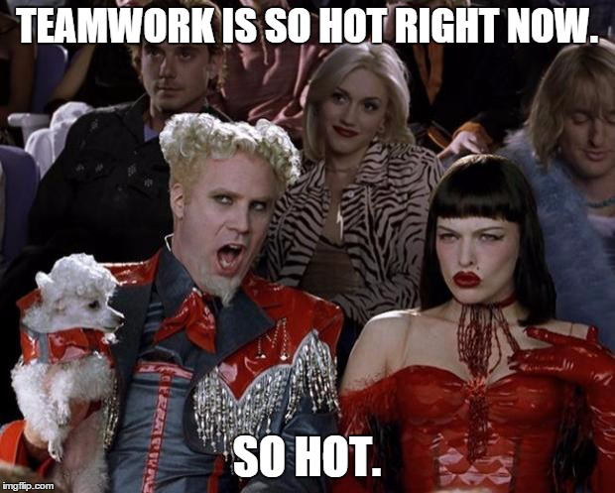
Making it political
In your groups, you will be given a hobby/issue.
You will need to:
  Connect it to politics;
  Connect to an issue of state concern;
  Connect to one or more of the 7 Deadly Sins.

