Slide 1
Triad J Seminar
Monday, February 1st

Slide 2
Review quiz
Say hello and introduce yourself to your neighbors around you.
I have a mini review over some of the thing you have gone over in political science.
You can use your notes and you can use the classmates sitting next to you.
You have 10 minutes to complete this.

Slide 3
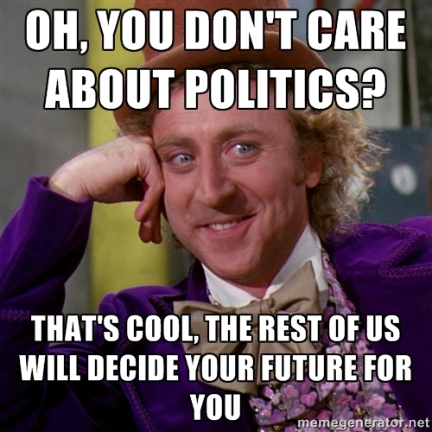
Sustainability:
Food for Thought
Your main research project will as you to connect an issue to:
  Politics
  Sustainability (What do you believe needs to be sustained?)
  Food for Thought (Why is this of great importance?)

Slide 4
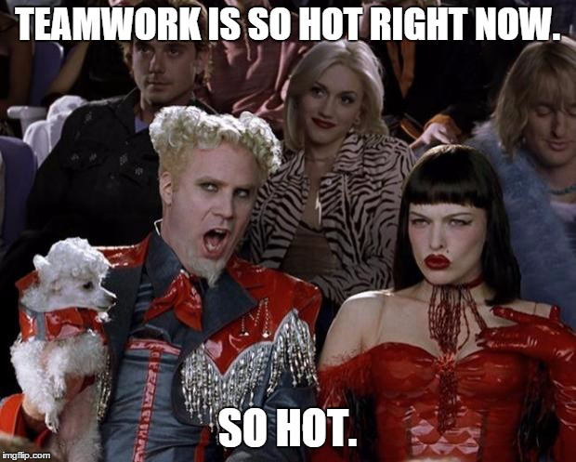
Making it political
In your groups, you will be given a hobby/issue.
You will need to:
  Connect it to politics;
  Connect to Sustainability;
  Connect to the idea of “Food for Thought”

Slide 5
Wednesday
Hope you haven’t forgotten, you have an exam in POLS.
We will do a small review on Wednesday.
I will also want to hear what two to three possible topic ideas you are considering for you major research project.

