Slide 1
Triad l seminar
Thursday, March 3

Slide 2
Class Outline
11am Lesson Plan
IA Proposal Discussion
Outline Discussion
APA Discussion
Facilitations Discussion
Homework
Conferences next Thursday
12:30pm Lesson Plan
Letter Formatting
Hand in peer review and look at new draft.
Facilitations Discussion

Slide 3
Seminar 492
Lesson Plan

Slide 4
Integrated Assignment: Research Proposal
Assignment description can be found on my Blackboard page under Content.
Brief intro.
This will be need to be uploaded to turnitin.com
If you were not able to create an account, you need to let me know.
turnitin.com demonstration…
Questions/Concerns?
Sample Proposal

Slide 5
APA Presentation
Can be found on my Blackboard page under Content and then under Integrated Assignment

Slide 6
Seminar Facilitations
Not all classes give study guides, have review sessions or even give lists of items to study for an exam.
It’s an important skills, to be able to create your own study guide and review, especially with you’re with a group.
These facilitations will give you that opportunity.
They also give the chance to, again, work on your presentation skills.
Instructions / Due Dates / Groups can be found on Blackboard.

Slide 7
Next Week
You need to finish your Integrated Assignment Proposal and upload by 11:59pm on Tuesday, March 8th to turnitin.com
Please do not email it to me. It must be uploaded to the above website.
Conferences next Thursday in my office, Faculty Center 119.
Make sure to sign up for a time before you leave.

Slide 8
Seminar 483
Lesson Plan

Slide 9
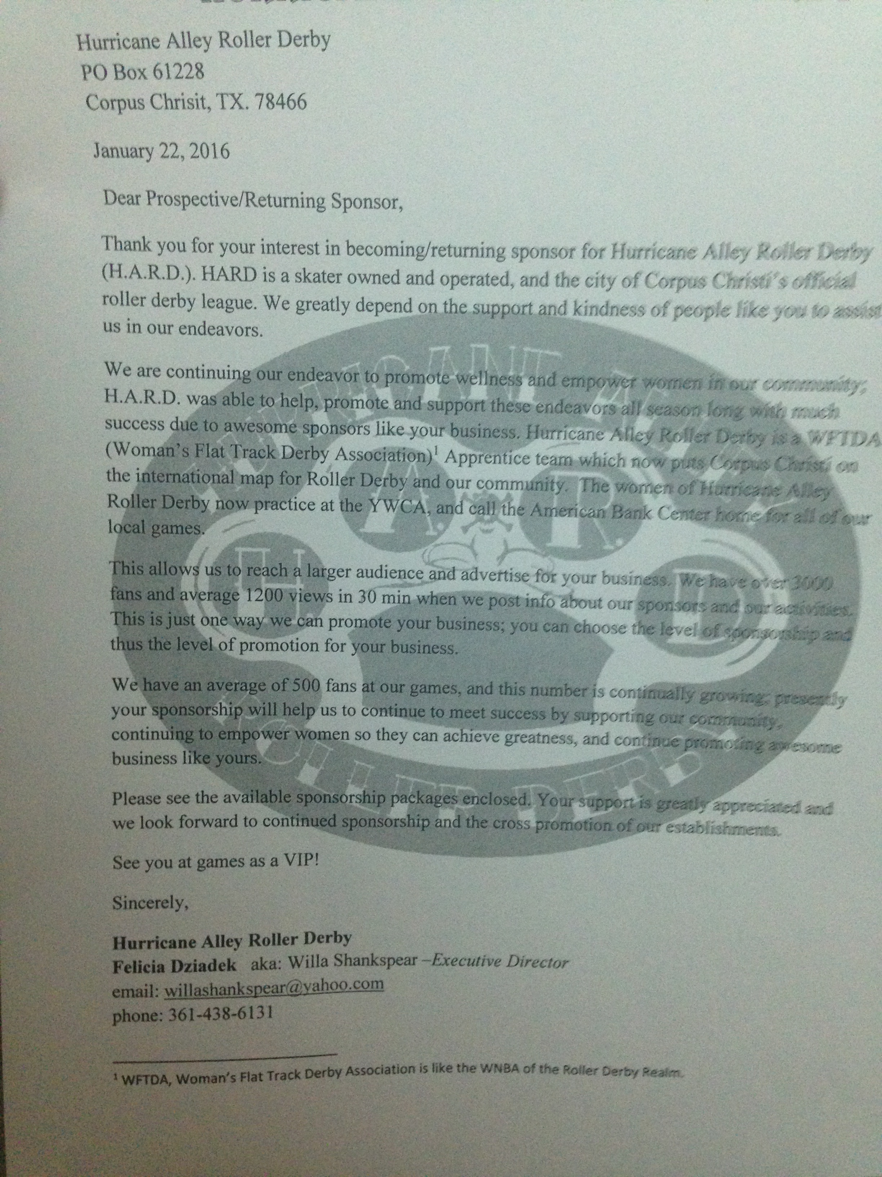
Integrated Assignment: Letter
Please make sure to turn in your original draft along with the peer edit form.
Make sure your names are on both.
Time to take out that new draft.

Slide 10
Letter Format
Top left header should have the full name of the company or person you are writing along with their address.
Next, put the date.
End with (preferably) Sincerely, and leave some space (for your signature) and then put your name along with your email underneath.
Don’t forget your Endnotes

Slide 11
Facilitations
Not all classes give study guides, have review sessions or even give lists of items to study for an exam.
It’s an important skills, to be able to create your own study guide and review, especially with you’re with a group.
These facilitations will give you that opportunity.
They also give the chance to, again, work on your presentation skills.
Instructions / Due Dates / Groups can be found on Blackboard.

