Slide 1
Triad J Seminar
Monday, March 28th

Slide 2
Important Due Dates
Registration worksheet is due Monday, April 4th, during your scheduled Conference time.
Registration begins: April 7th for Sophomores and April 8th for Freshmen.
Final day to drop is Friday, April 8th.
Conferences on Monday, April 4th
You will need to register for a conference time before you leave today.

Slide 3
Multimodal Projects
Adapted from CASA’s presentation

Slide 4
Multimodal Essentials
Use multiple modes (types) of communication to convey content (research) to your audience.
words, sounds, images – still or moving
Consider the rhetorical impact of your choices.
How will your audience respond to these words, sounds, and/or images?

Slide 5
Multimodal Options
Slide-based presentation – PowerPoint, Prezi
Short video or commercial
Interactive website
We are going to discuss a few options for creating a Multimodal presentation – but whatever you choose, you must integrate MULTIPLE MODES OF COMMUNICATION. That is, different ways of communicating. Combining words with images / movement with images and words / sound with movement, etc.

Slide 6
Power Point

Slide 7
Pecha Kucha: A Method of Organizing
Carefully select images for 20 slides (using PowerPoint).
Use minimal to no text on each slide.
Adjust PowerPoint to transition between slides automatically every 20 seconds.
Create brief speaking points to discuss for each side.
This type of presentation requires that the presenter rehearse their presentation.
Why do you think this type of presentation could be useful?

Slide 8
Prezi

Slide 9
Windows Movie Maker

Slide 10
Powtoon

Slide 11
Presentation Tips
Do not try to include everything in your presentation.
Include the most important or significant elements of your research.
Create notes for your presentation and practice rehearsing.
Use clear transitions and key words/phrases to guide audience through your presentation.
Draft, revise, and practice your presentation.
Seek feedback from others.

Slide 12
Font/Text
Use simple and easy-to-read fonts.
Use a font size that is readable by audience.
Maintain consistency in fonts and font sizes.
Cambria
Times New Roman
Bookman Old Style
Arial
Calibri
Tahoma

Slide 13
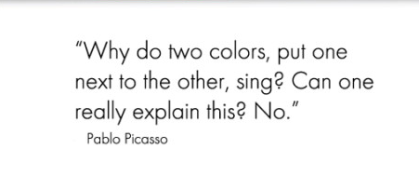
Using Colors
Consider which colors are compatible with content of presentation.
Color can convey meaning to your audience and can influence their attitudes and/or feelings.
Create a balance between color of words and color of background.
To learn more about using and/or combining colors, research color theory.
Avoid complex patterns.

Slide 14
Using Images
Have a purpose for using every image.
Ask yourself, “What is the purpose of this image in my presentation?”
Avoid the use of irrelevant or repetitive images.
Use editing tools to improve and crop an image if necessary.
Caption and cite image(s) accordingly.
Figure 1. Image of open book on wooden table. Retrieved from http://www.google.com/imghp

Slide 15
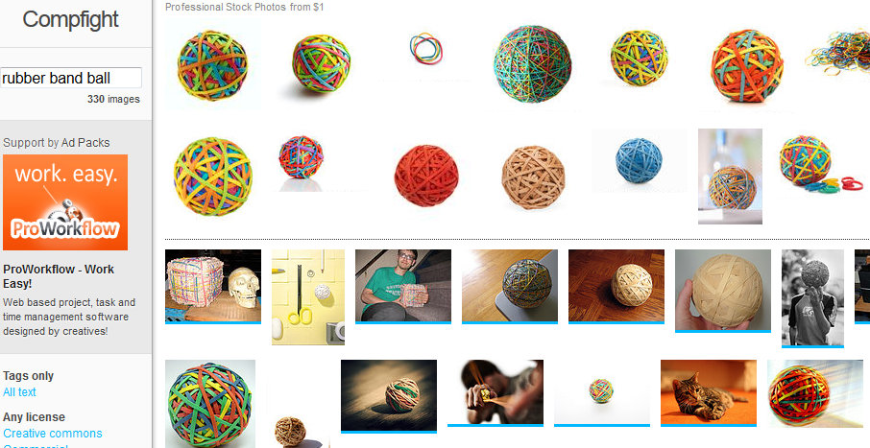
Resources for Finding Images
Compfight
Is accessible online and contains a search tool to search for key terms and download images. Cite all images!

Slide 16
Resources for Finding Images
The Noun Project

Slide 17
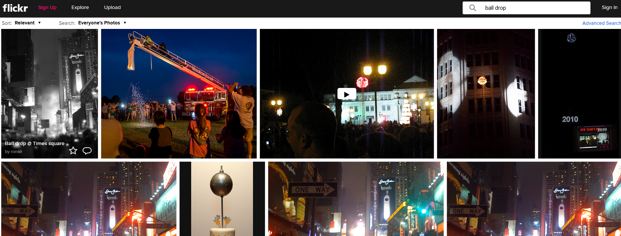
Resources for Finding Images
Flickr

Slide 18
Citing an Image Found Online in APA
Creator Last Name, First initial. (Year).
Title of work. [Medium: painting,
drawing, photograph, etc.].
Retrieved from http://xxx
If creator name is not available, cite by the title of the work.
Portrait from Down Beat Magazine.
(1947). [Photograph]. Retrieved
from http://www.wikipedia.org

Slide 19
Using Video
Using a portion of a video can be a useful element to include in your presentation.
Limit the length of video clip(s).
Cite the video.
Embed video file(s) in your presentation.
Closing your presentation to open a video in another program can detract from the professionalism of your presentation.

Slide 20
Citing a YouTube Video in APA
Author, A. A. [User Name]. (year,
Month day). Title of video [Video
file]. Retrieved from http://xxxx
User Name. (year, Month day). Title of
video [Video file]. Retrieved from
http://xxxx
Man, K. (2013, April 3). Writers on
writing – Charlie Rose [Video file].
Retrieved from
http://www.youtube.com

Slide 21
Using Sound/Music
Using sounds and/or music can enhance your presentation.
Consider the connection between your topic and the sounds and/or music.
What do you want your audience to think or feel when they hear it?
Embed audio file(s) into your presentation.

Slide 22
References
Lunsford, A. A. & Ruszkiewicz, J. J. (2004). Everything’s an argument. Boston,
MA: Bedford/St. Martin’s.
Online Writing Lab Purdue University. (2013). Introduction to color theory.
Retrieved from https://owl.english.purdue.edu/
Ruszkiewicz, J. J. (2009). How to write anything: A guide and a reference.
Boston, MA: Bedford/St. Martin’s.

Slide 24
Time for a Practice Run
In your groups, you will create a presentation that discusses a shared interest that you have.
Discuss what the interest is;
Why you each like this interest;
Try to persuade your audience to like this interest or at least give it a chance
Your presentation will need to be (for this practice run) either a PowerPoint / Prezi / Powtoon
Visuals are important along with minimized text.
Make sure to cite and have a reference page!!
Length: 5-10 min
Due Wednesday, March 30st, before Seminar.

