Slide 1
Compinar Conferences
Wednesday, February 24th in my office (Faculty Center Room 119).
You will be meeting with Prof. Sheffield and myself.
So, no Composition or Seminar on that day.
We will be discussing your topic proposal that will be on Friday, February 26th.
You will need to sign up for a conference time before you leave today.

Slide 2
Triad J Seminar
Monday, February 15th

Slide 4
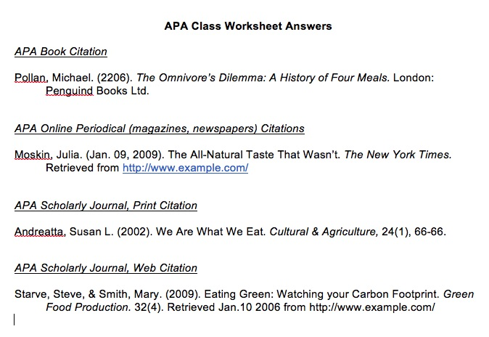

Slide 5
Planes / Pilots / Politics
The Issue and Political Connection
New Training Hours
Federal Aviation Administration (Boom! Political connection, right there.)
Implemented a change requiring pilots to have a minimum of 1,500 flying hours of flight time before they could serve as a first officer in a regional jet.
That is up a lot from the previous requirement of 250 hours.
That is due some crashes and incidences caused by pilot fatigue and insufficient training.
The training requirement is a federal issue while the availability for that training is a state issue

Slide 6
Planes / Pilots / Politics
The Viewpoints
This is a controversial topic to say the least.
Passenger advocates and the families of crash victims have been strongly opposed to any suggestions that the rule should be loosened.
Airline companies have not completely fully supported the change, especially since there is a shortage of pilots and the shortage will only increase in the next few years.
Military Pilots / Four-Year School Graduates – Should they be entitled to certain reductions from that 1,500-hour requirement?

Slide 7
Topic Presentations
Time to present your topics.
Make sure to discuss your:
Your topic
The issue you would like to address
Any concerns you may have:
Such as how to connect it to politics
Or if you’re worried about how to research it

